Slide 1
VENDOR ANALYSIS FROM DIVERSE MARKETS
Understanding Vendor Landscapes Across Countries

Slide 2
AGENDA
Introduction
Descriptive Statistics
Vendor Analysis
Key Findings
Conclusion

Slide 3
INTRODUCTION
Businesses hoping to succeed in a variety of marketplaces must grasp the vendor dynamics across national borders in today's integrated global marketplace.
In-depth vendor relationship landscapes are explored in our presentation, "Global Vendor Analysis: Insights from Diverse Markets," which provides insightful information gleaned from careful research undertaken in multiple nations.
We examine the techniques used to analyze vendor landscapes, emphasizing the important variables taken into account during our assessment procedure.

Slide 4
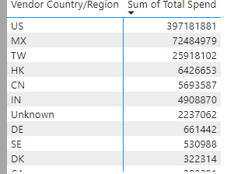
Descriptive Statistics
The Vendor analysis dataset consists of vendors from different countries in 300 across the globe and how much they spend.
Below is a sample data of the different countries and how much the vendors spent.

Slide 5
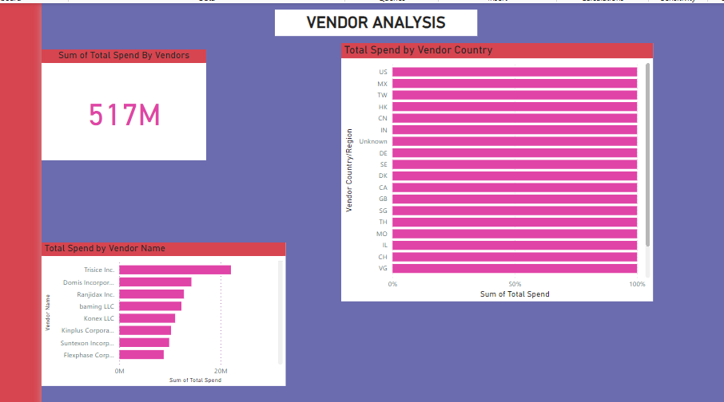
Vendor Analysis
Below is analysis of Sum spent by vendors the different countries they come from and their names starting with the highest spent vendor.

Slide 6
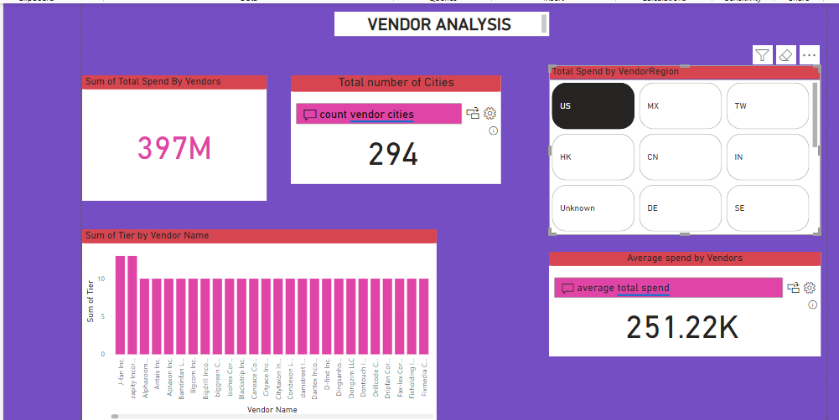
Vendor Analysis Of Countries

Slide 7
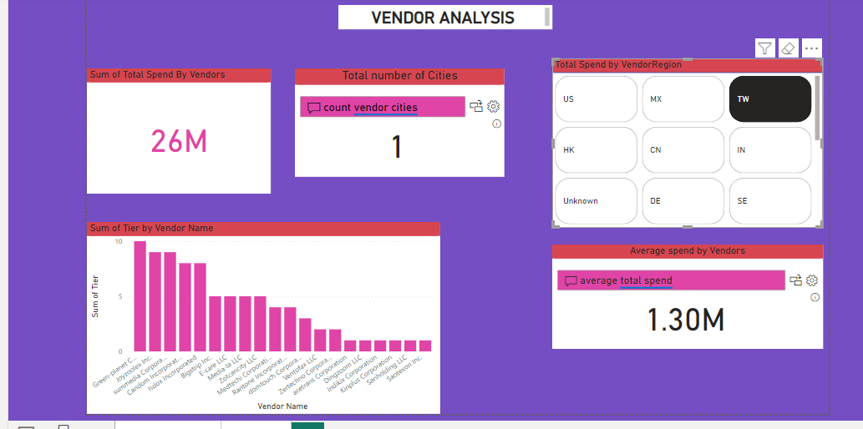

Slide 8
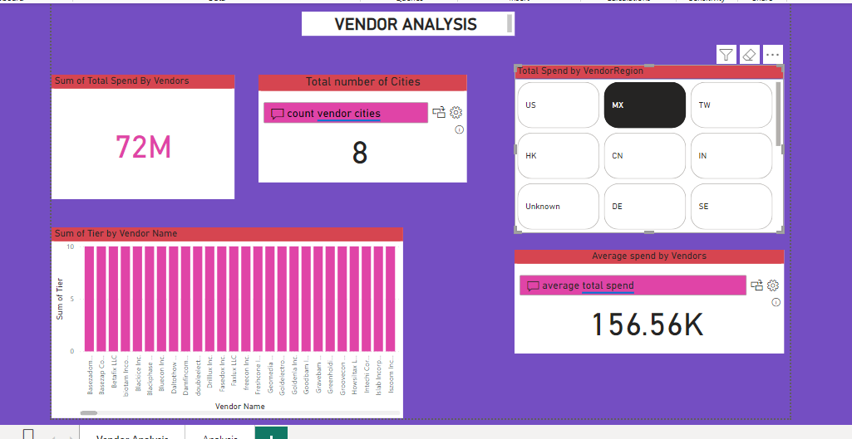

Slide 9
Key Findings
Across the analyzed countries, vendors exhibit varying degrees of market penetration, with some enjoying dominant positions while others struggle to gain traction.
The Us is the leading followed by MX and lastly TW
The competitive landscape is highly dynamic, with new entrants challenging established players in several markets.

Slide 10
References
https://learn.microsoft.com/en-us/power-bi/create-reports/sample-datasets#download-sample-excel-files
https://community.fabric.microsoft.com/t5/Desktop/Need-raw-data-behind-Power-BI-obvience-samples/m-p/678271#M326562

Slide 11
